Slide 1

Woof
Nafis Abeer, Justin Lam, Chase Maivald, Rajiv Ramroop, Daniel Shimon

Slide 2
TABLE OF CONTENTS
01
02
03
04
Introduction
Progress report
Gantt Chart
Big Picture
Problem statement & project description
Each member described what they have completed and what needs to be done
Completion timeline
Updated diagram and final deliverables to be expected

Slide 3
Problem Statement
No current mainstream application catered towards just dog-owners
Prob 1
Prob
3
Community
App!
Dog Friendly
Tracking
No current application exists that leverages information about dog behavior and caters to their feelings
Keep track of dogs and when friends are in the park
Prob 2

Slide 4

Project properties
Key Requirements
Dog-Maps relaying friends locations in real time
Add-Friends
Accurate friends suggestions based on dog behavior
Real time tracker for lost dog
Social media application interface
Microcontroller collecting audio feed
*Bonus* Says dog’s current movement
GPS information
Add friends with recommendations
Recording capability for audio
Sending data when BLE detected
Authentication for read/write access to user profile information

Slide 5
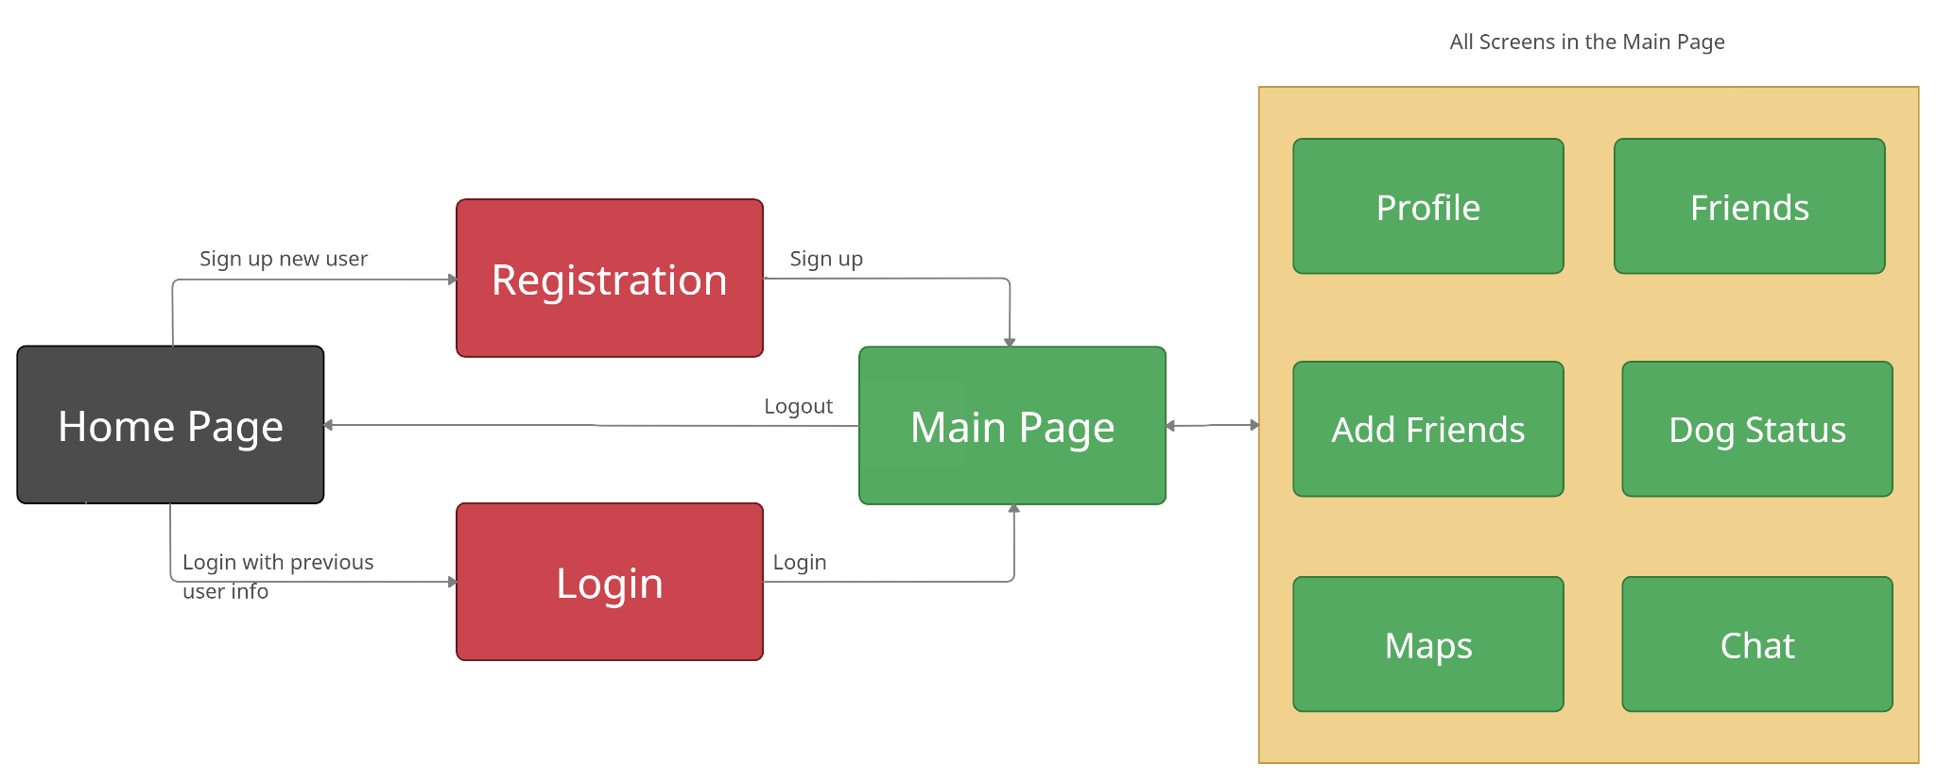
Justin - User Interface Screen Flow

Slide 6
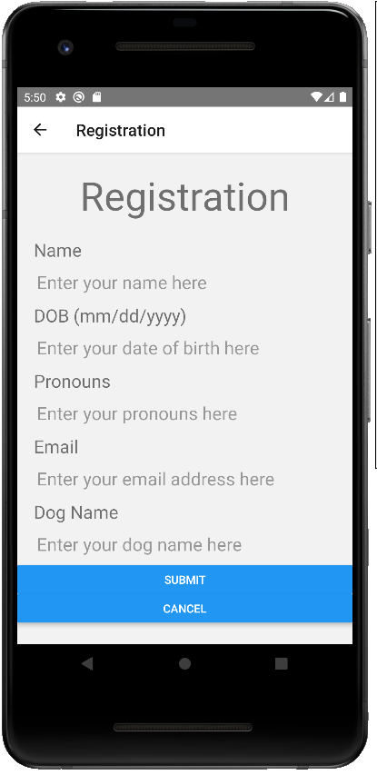
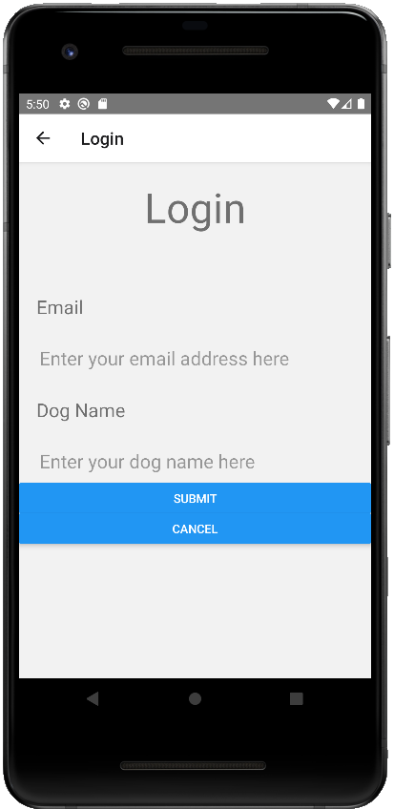
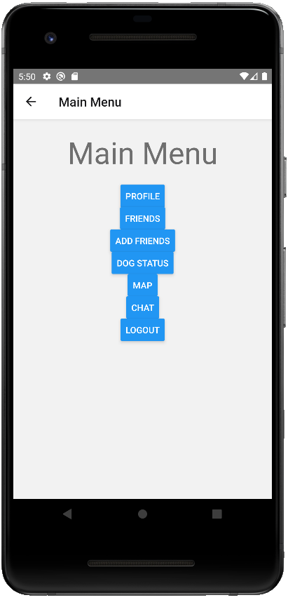
Justin - User Interface

Slide 7
Justin - Accomplishments/Need to complete next few weeks
Accomplishments:
Functional UI to complete last part of end to end testing
Worked on AWS Azure instead of Firebase for authentication (not complete) (will be easier to connect to our AWS EC2/SQL)
Need to finish:
More css finishing touches
Get AWS Azure to work 100% (sometimes it doesn’t work)
Connect it to our database Chase developed

Slide 8
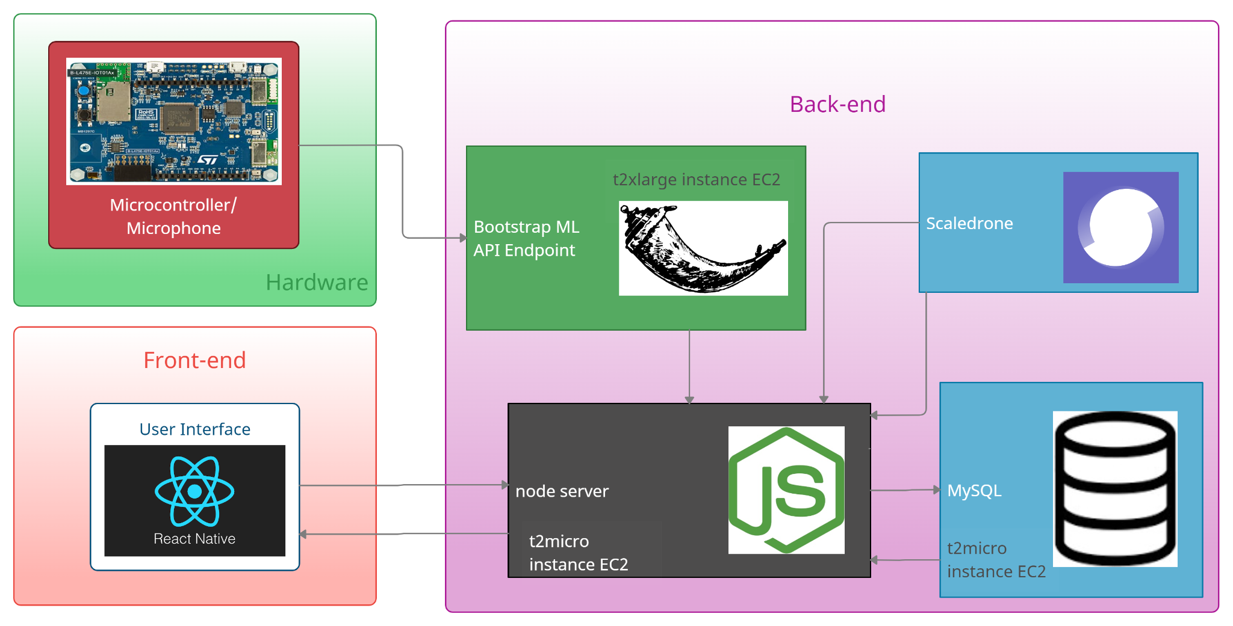
Daniel - End to End Data Flow
Notes:
T2micro EC2

Slide 9
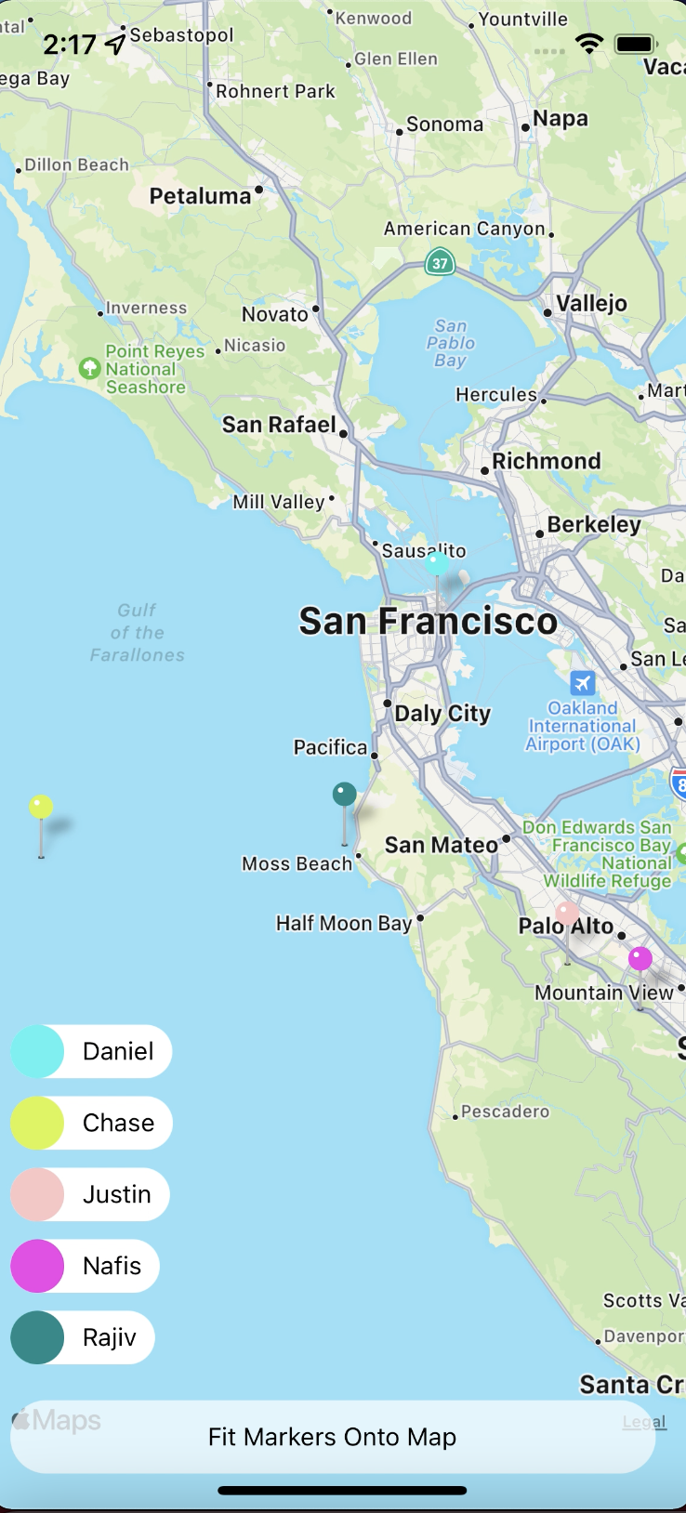
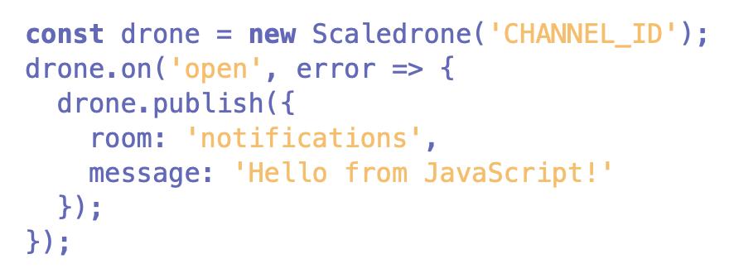
Daniel - Map Component
React Native Maps
Scaledrone
Realtime Messaging Service
Create Rooms for all Users
Chat Functionality
Location Functionality
JSON Web Token Authentication / REST API

Slide 10
Daniel - What’s left for the Map Component
Integration
Already know how to scale away from local server and be able to run on devices, just need to implement
Include user GPS data as opposed to random movements on current map

Slide 11
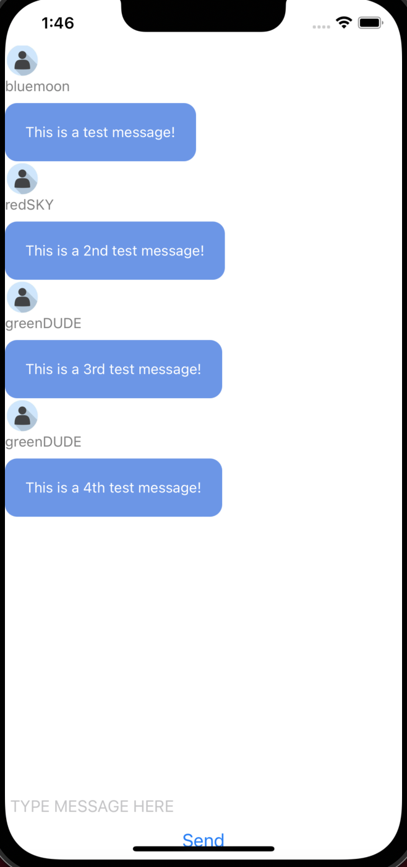
What’s left for Chat Component
Scaledrone
Same exact components as Map which made development easier
Users are able to send messages. All that’s left is Scaledrone connection + Database connection

Slide 12
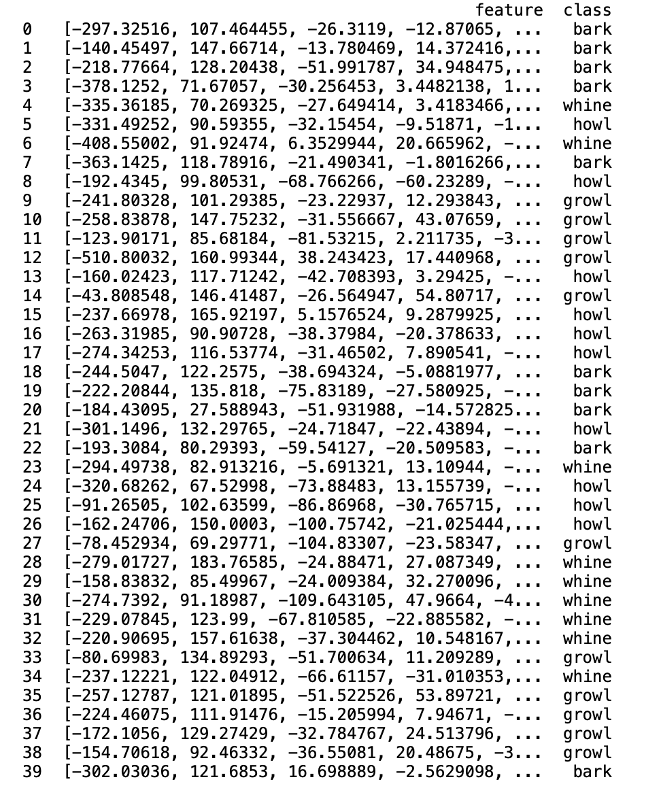
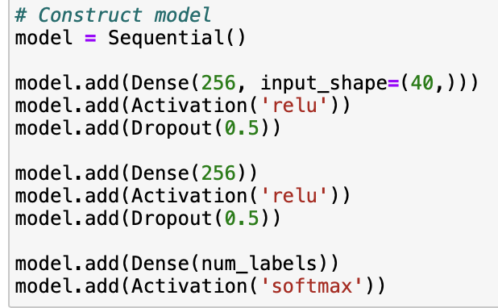
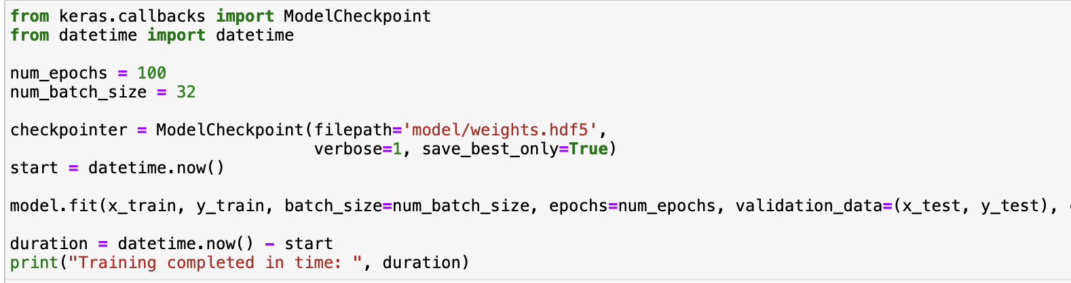
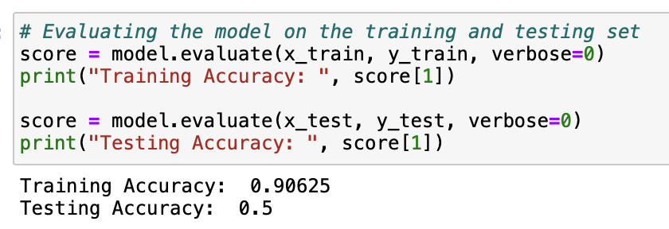
Nafis - Dog Bark Classification

Slide 13
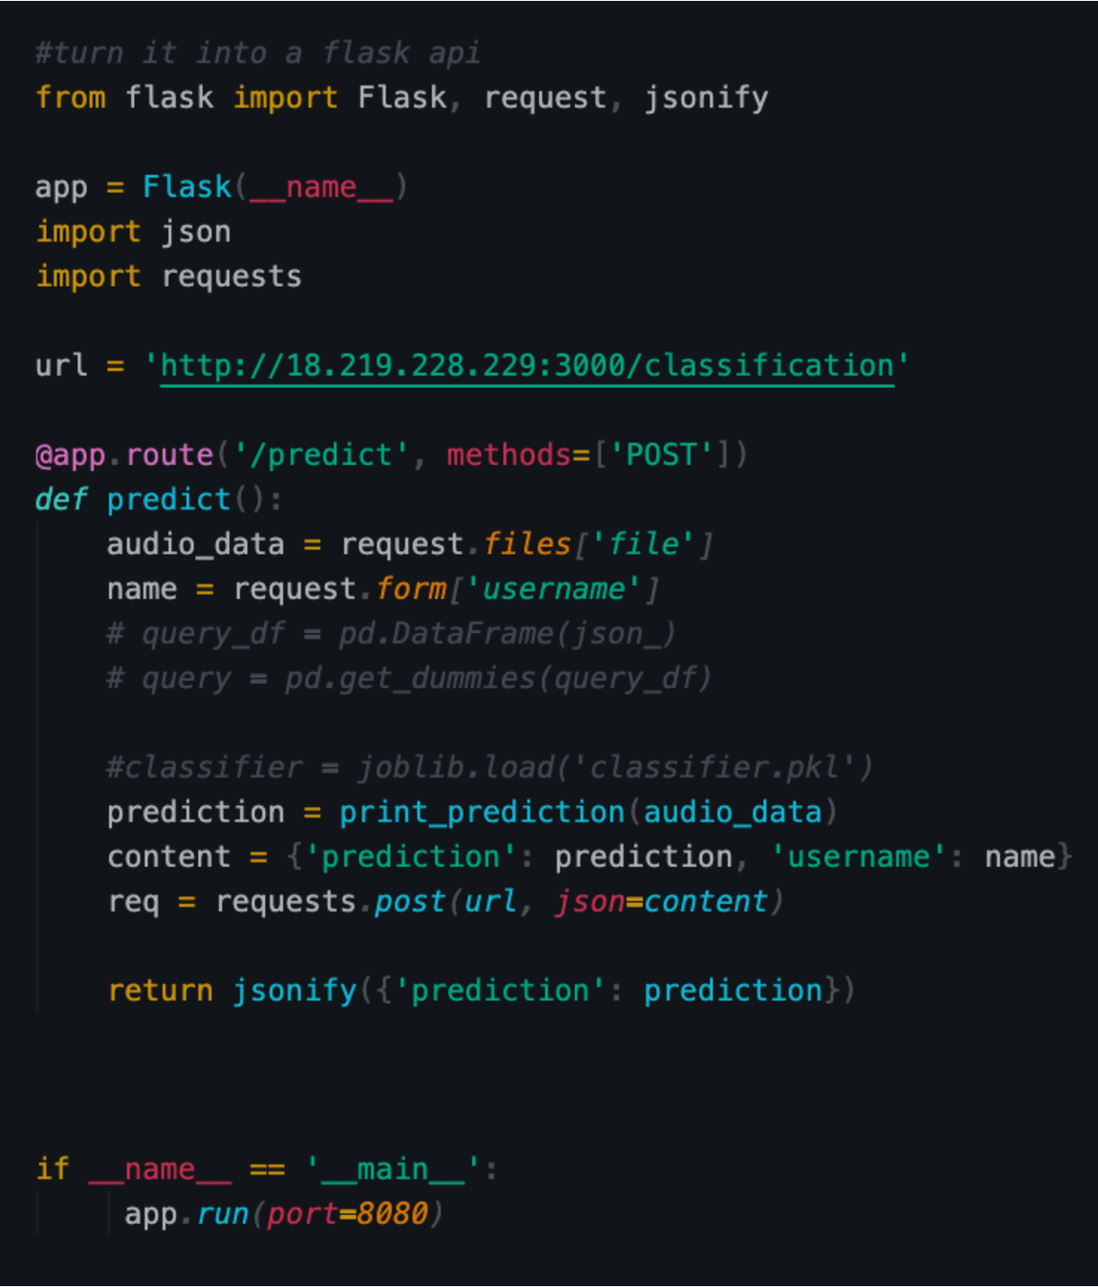
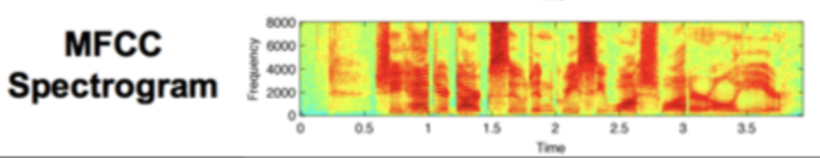
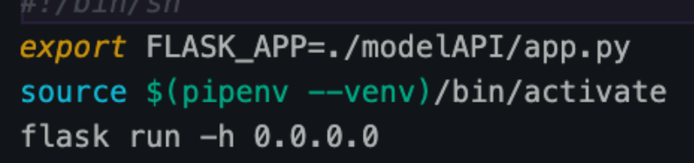
Nafis - ML Model API
Use Model developed last semester to detect classify dog barks in audio
Normalize audio files to have similar sample rates, bit-depths and number of audio channels
Convert audio files to spectrograms and run image processing to classify audio
Model API - Flask API hosted on AWS EC2

Slide 14
Nafis - Accomplishments/Need to complete next few weeks
Accomplishments:
Could save ML models, deploy them to EC2
Got data collection method and good amount of data for dog bark classifier
Deployed FLASK REST API for ML model to AWS EC2
Could send predictions to node server and receive audio from hardware with MAC addr
Need to finish:
Accuracy for dog bark classifier

Slide 15
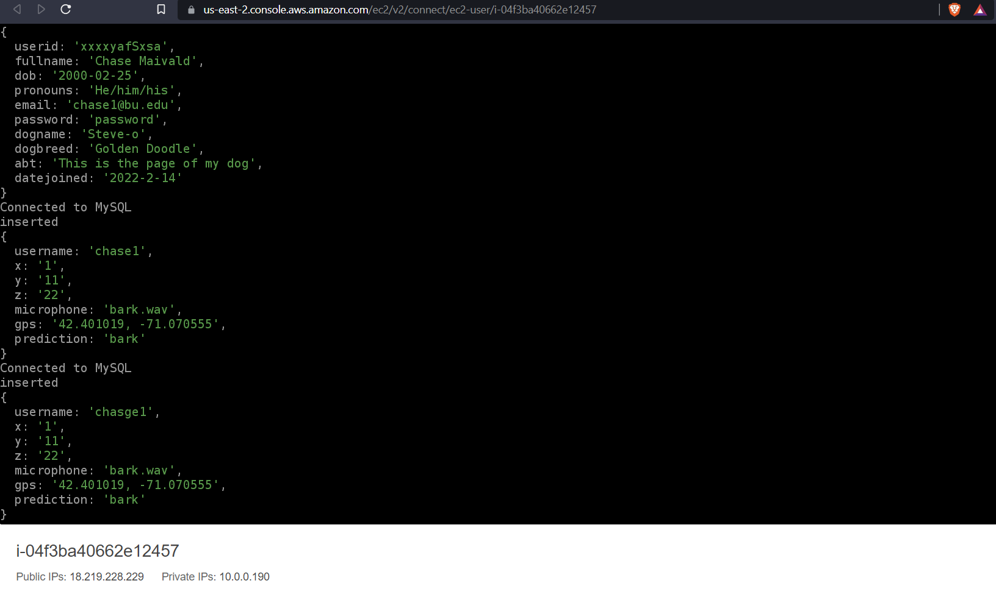
Chase - Server

Slide 16
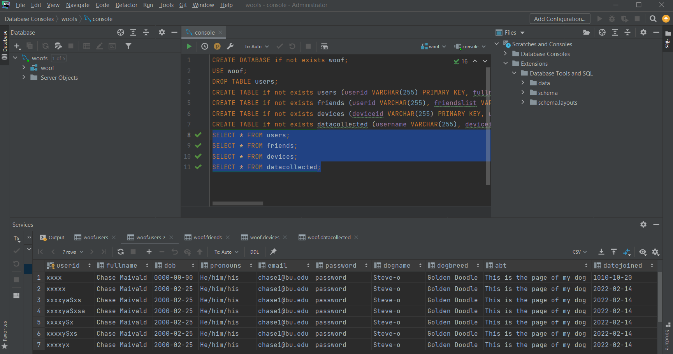
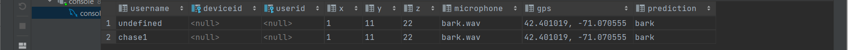
Chase - Database

Slide 17
Chase - Accomplishments/Need to complete next few weeks
Accomplishments:
Database for inserting and reading user, friends, device data, and data collected
Configured security groups for a public facing EC2 server instance to the private RDS hosting MySQL for a more secure connection
Need to finish:
Storing each user’s userid as their hardware’s MAC address
Store each user’s authentication details and reference authentication data to persistently allow a user to access their data

Slide 18
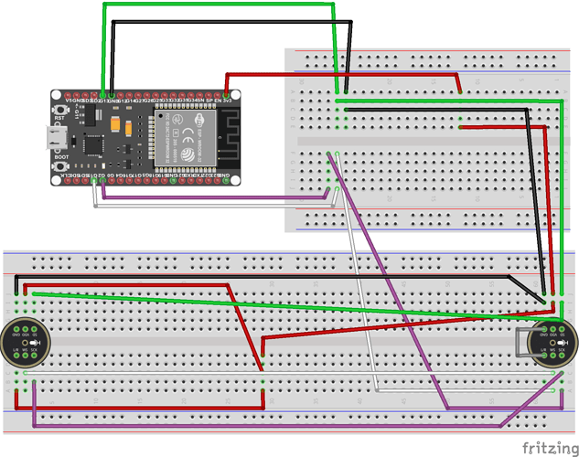
Rajiv - Hardware Data collection
We use the ESP32 microcontroller for collecting microphone data
This will be rechargeable, powered by a micro-usb or a 5V lithium battery
Already capable of collecting accelerometer data as well

Slide 19
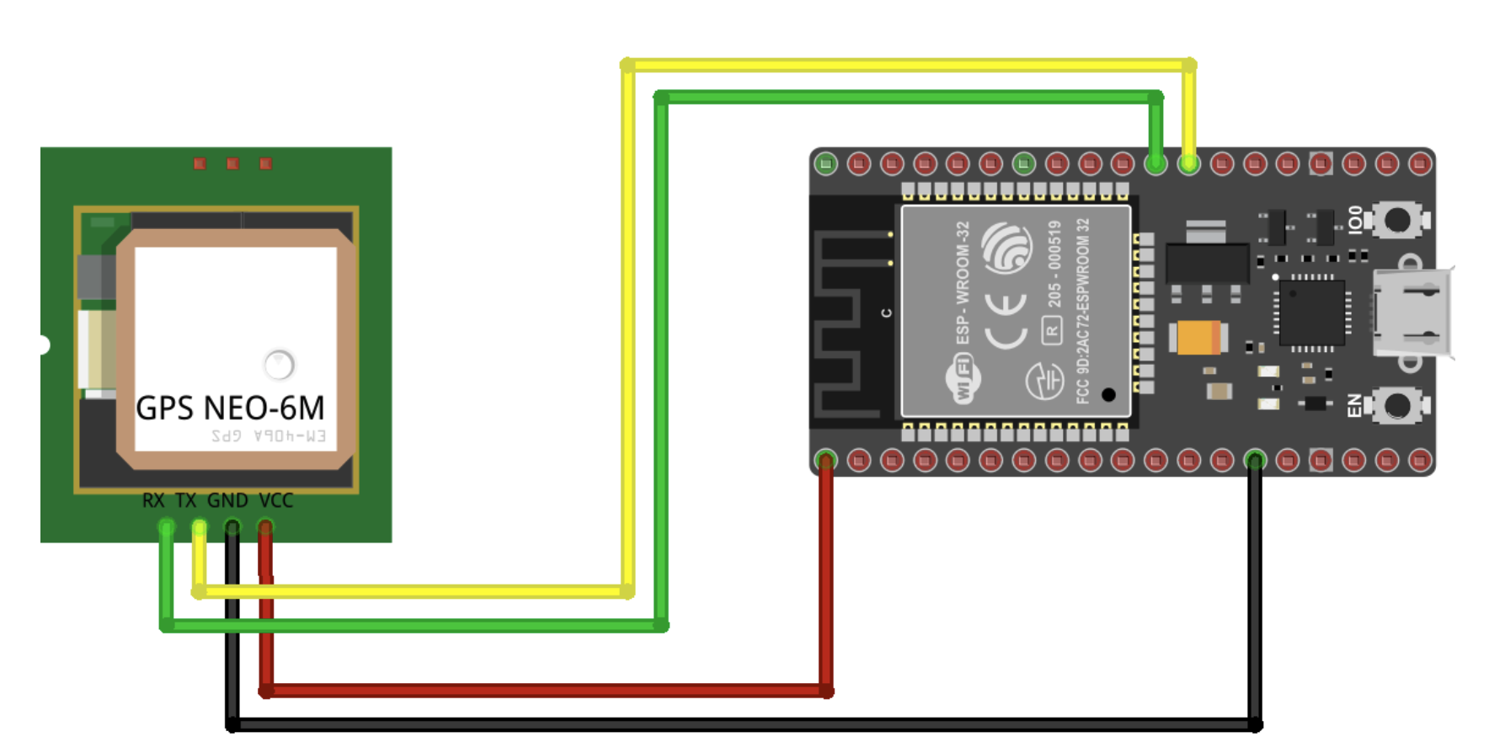
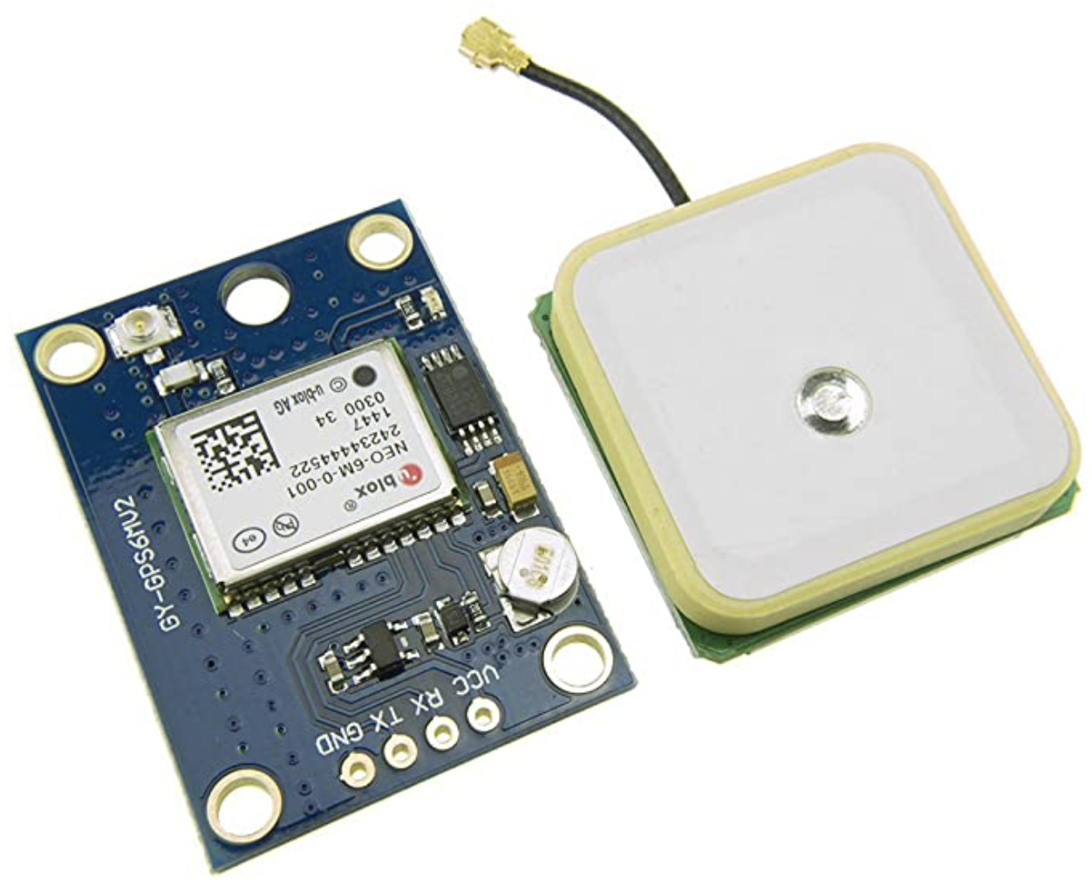
Rajiv - ESP32 GPS (To be completed)

Slide 20
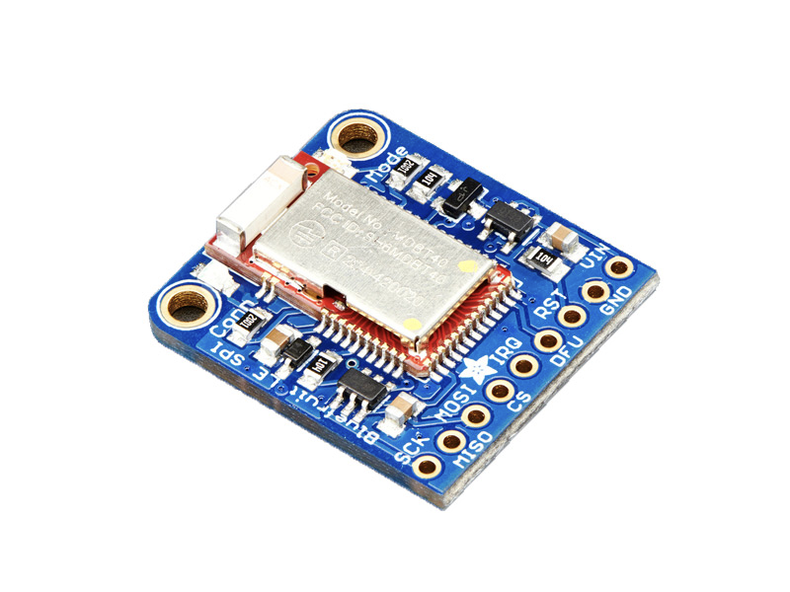
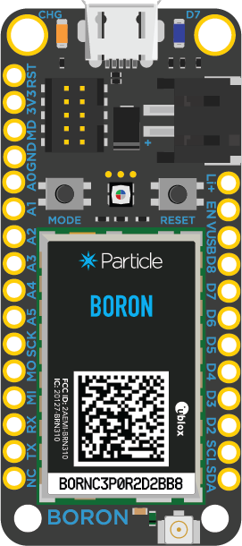
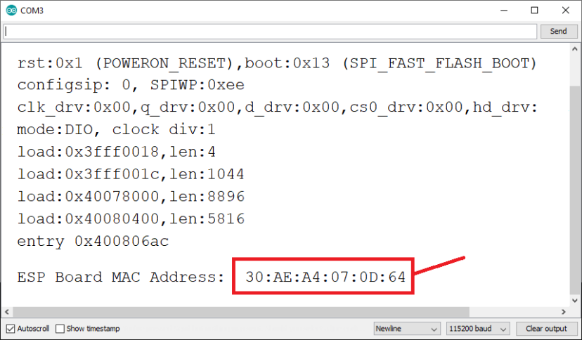
Rajiv- Sending Data (What needs to be completed)
When the BLE signal strength is strong, we send data
Received Signal Strength Indicator value ranges from -100 to 0
Data will be sent to Flask via REST call
We will utilize each device’s MAC address to classify a user
Boron-LTM (When shows up) can utilize modem
.wav file sending at 1 Mb/s

Slide 21
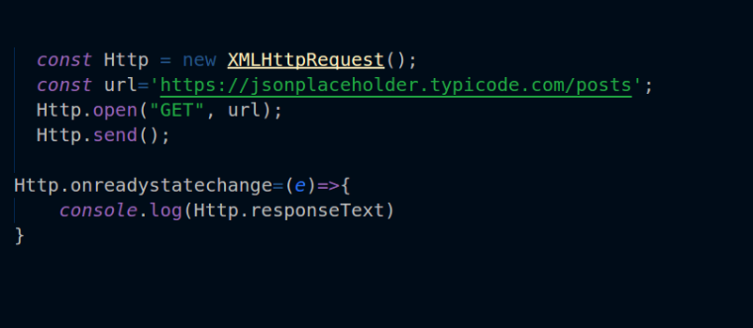

Rajiv- Sending Data (What needs to be completed)
Sending data via API Calls
Utilizing HTTP POST to send live sensor data

Slide 22
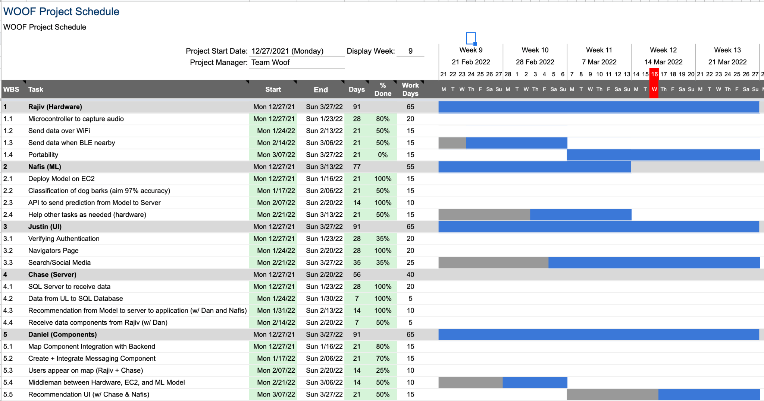
Gantt Chart

Slide 23
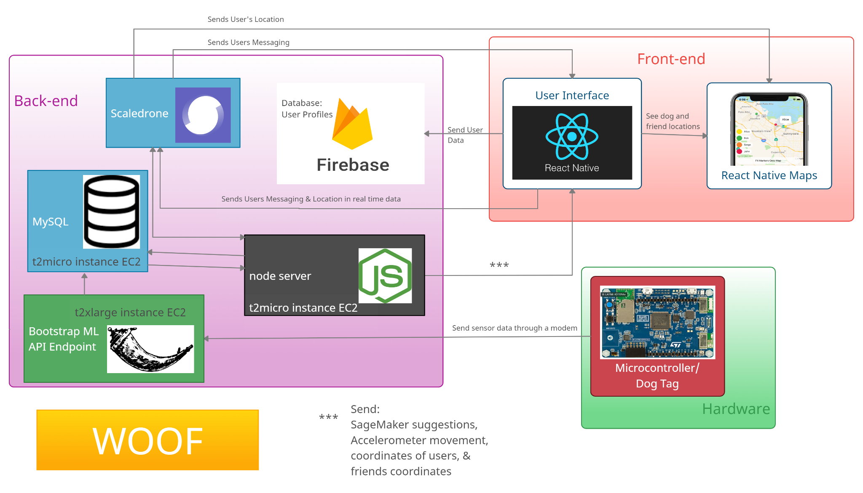
System Block Diagram
Notes:
EDIT THIS!!!!!!

Slide 24

Do you have any questions?
Yes

